Slide 1
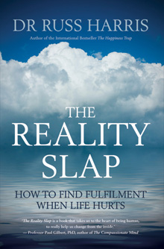
The Reality Slap
Visit ‘Free Resources’ on www.actmindfully.com.au

Slide 2
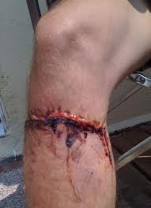
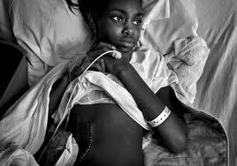
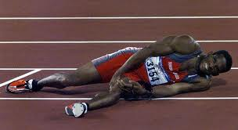
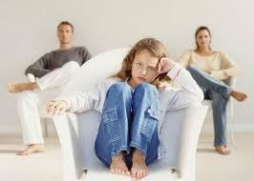
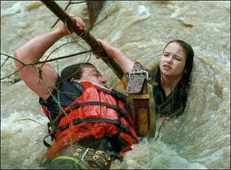
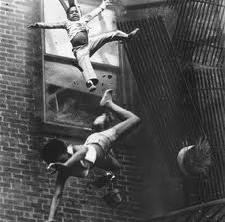
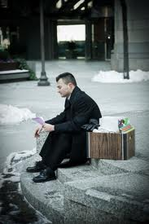
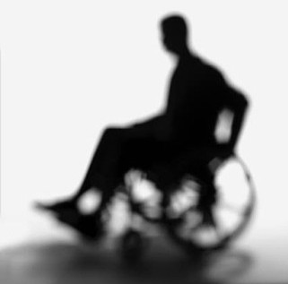
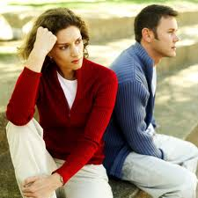
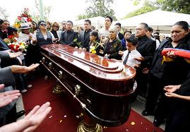
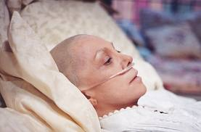
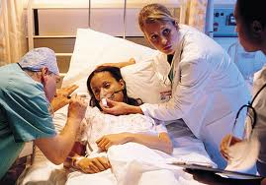
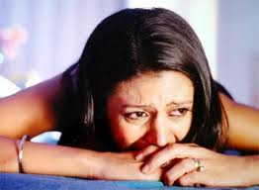
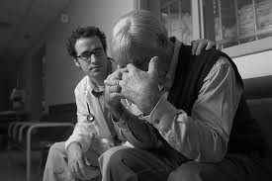
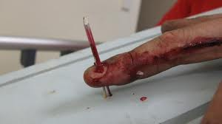
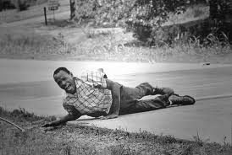
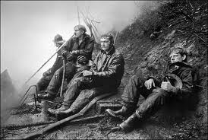
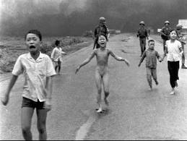
THE REALITY SLAP
THE REALITY GAP
Notes:
In my years as a GP, I met many people who had suffered terribly in life. I saw children disfigured by fire and babies with fatal diseases. I saw strong, capable adults reduced to invalids and brilliant minds wiped away by dementia. I saw bodies misshapen and deformed through all manner of injury—the victims of violence and disaster. I saw refugees from foreign lands, struggling to rebuild their lives after rape and torture or trying to start again after losing most of their family. I saw the freshly bereaved, howling in their anguish, distraught mothers clutching their stillborn babies. I saw men with weeping sores and blistering skin and women with broken bones and bleeding arteries. I saw the blind, the deaf, and the paralysed, the seriously ill and the newly deceased.
And in the midst of all this pain, I saw courage, kindness, and compassion. I saw people reaching out and helping each other, families bonding through crisis, friends and neighbours holding each other’s hands. I saw men and women facing death with dignity; love and affection pouring from broken hearts. I saw parents slowly rebuilding shattered lives, finding the strength within to persist and grow.
It never ceases to amaze me that in the midst of great pain we find great passion.

Slide 3
The 3 Ps
Presence
Purpose
Privilege

Slide 4
The 3 Cs
Connection
Caring
Contribution

Slide 5
Elisabeth Kübler-Ross: 5 stages of grief
denial
anger
bargaining
“depression”
acceptance

Slide 6
4 Steps
Beware
of Invalidation
Hold Yourself Kindly
Drop Anchor
Take A Stand
Find The Treasure

Slide 7
The 3 Cs
Connection
Caring
Contribution

Slide 8
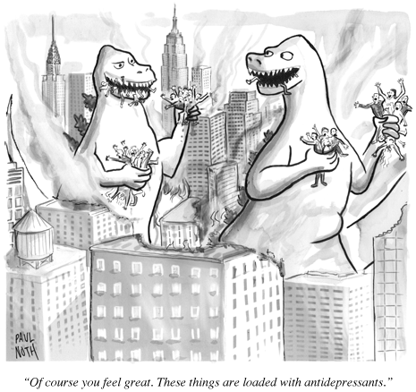
“Of course you feel great. These things
are loaded with antidepressants.”

Slide 9
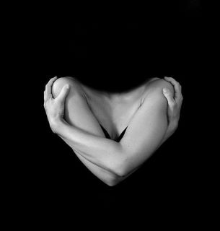
Hold Yourself Kindly

Slide 10
Self-Compassion
Kristin Neff:
Mindfulness
Kindness
Common humanity

Slide 11
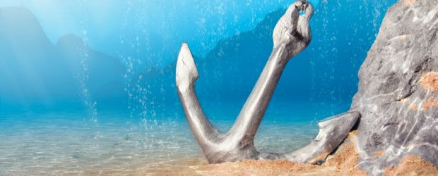
Drop Anchor

Slide 13
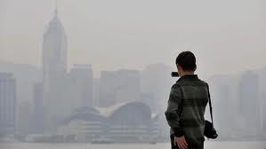
Psychological Smog

Slide 14
Be Like A Tree

Slide 15
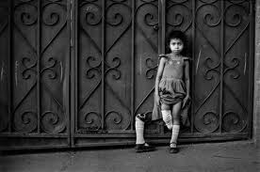
Take A Stand

Slide 16
The Resilience Formula
4 approaches to any problem situation:
1. Leave
2. Stay & change what can be changed
3. Stay & accept what can’t be changed & live by your values
4. Stay & give up & do stuff that makes it worse
Notes:
Sitting on the fence metaphor

Slide 17
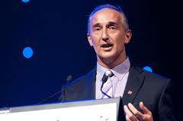
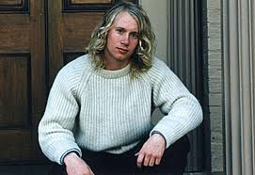
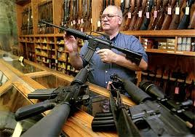

Slide 18
A Useful Question
Imagine 10 years from now, you look back at the way you responded to this event. What would you like to say you stood for in the face of this? About the way you responded, the way you handled it?

Slide 19
Other Useful Questions
If you wanted to be a good role model for someone you really care about, what would you model for them in the way you respond to this?
Suppose it had been you that died; and you could somehow look on from the afterlife and watch over the people you care about - what would you want for them? How would you want them to respond to this?

Slide 20
The 3 Cs
Connection
Caring
Contribution

Slide 21
My creative pursuits
Myself
My family
My religion
My work
My sport
CONNECTION
My friends
My fun and games
I
Here
Now
CARING
My body
My studies
My society
CONTRIBUTION
My thoughts & feelings
My planet
My dog, cat, fish,
rabbit
My house

Slide 22
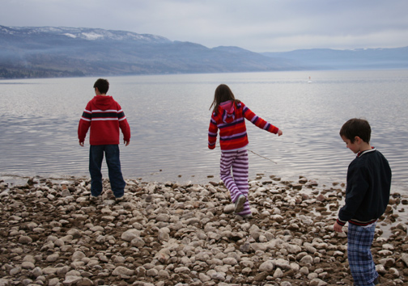
Find The Treasure
Beware
of Invalidation

Slide 23
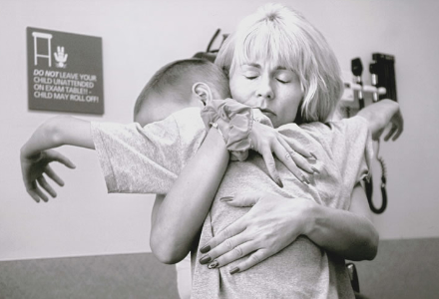
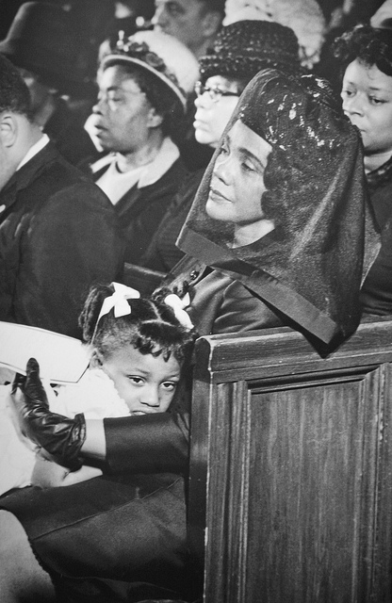
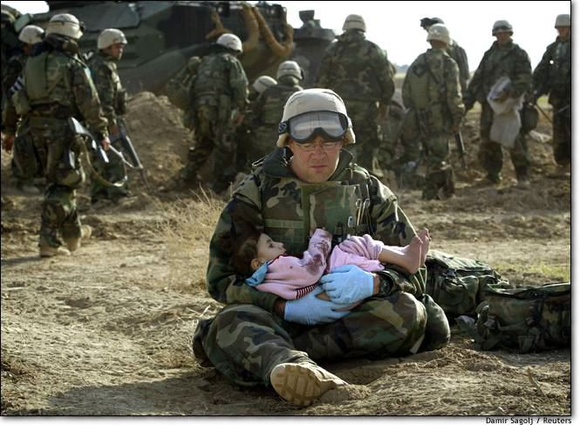

Slide 24
What Treasure?
Love, kindness, compassion
Moments of awe, wonder, amazement
How can I grow from this?
What skills can I learn?
What strengths can I develop?
What relationships can I deepen?

Slide 25
The 3 Ps
Presence
Purpose
Privilege
Notes:
The more we reflect on the privilege of human emotion—that we get to care and to feel in so many different ways—the more we can appreciate all our emotions. This privilege does not come without a price. With passion comes pain. With caring comes loss. With wonder comes fear and dread. But look at the upside: consider what your life would be like without it.
And consider this too: What is the key to lasting fulfillment? What is the essence of human vitality? What is the core of all those things we call “love”? It is to care, connect, and contribute—to live with presence and purpose. Surely there is no greater privilege than this.

Slide 26
Kahlil Gibran, The Prophet
Your joy is your sorrow unmasked.
And the self-same well from which your laughter rises
was oftentimes filled with your tears.
And how else can it be?

Slide 27
Kahlil Gibran, The Prophet
The deeper that sorrow carves into your being,
the more joy you can contain.
Is not the cup that holds your wine the very cup that
was burned in the potter's oven?
And is not the lute that soothes your spirit,
the very wood that was hollowed with knives?

Slide 28
Kahlil Gibran, The Prophet
When you are joyous, look deep into your heart and you shall find it is only that which has given you sorrow that is giving you joy.
When you are sorrowful look again in your heart, and you shall see that in truth you are weeping for that which has been your delight.

Slide 29
There is a sacredness in tears.
There is a sacredness in tears.
They are not the mark of weakness, but of power.
They are not the mark of weakness, but of power.
They speak more eloquently than ten thousand tongues.
They speak more eloquently than ten thousand tongues.
They are messengers of overwhelming grief ... and unspeakable love.
They are messengers of overwhelming grief ... and unspeakable love.
– Washington Irving
– Washington Irving

